Slide 1

Anti-Racist Pedagogy Series:
Anti-Racist Action and Advocacy
July 28, 2020
Faculty Center for Ignatian Pedagogy

Slide 2
  Acknowledgements
  The Loyola community occupies the traditional homelands of the people of the Council of Three Fires, the Ojibwe, Potawatomi, and Odawa as well as the Menominee, Miami and Ho-Chunk nations. This was also a site of trade, travel, gathering and healing for more than a dozen other Native tribes and is still home to over 100,000 tribal members in the state of Illinois.
  Thank you to our contributors*:
  Sasha Adkins
  Rebecca Flores-Valeriano
  Ruth Gomberg-Muñoz
  Susan Haarman
  Sandra Sullivan-Dunbar
    *Jon Schmidt is not presenting, but did offer helpful feedback for the planning of this session.

Slide 3
Session Agenda
  Discussion of action in community
  How to introduce opportunities for anti-racist advocacy and action into your courses
  Discussion of high impact practices and programming for marginalized student groups
  How to advocate for anti-racism and take anti-racist action in research, academic departments and other work, including community engagement

Slide 4
Shared assumptions
We endeavor to move toward anti-racism in the classroom and as an institution.
We must listen to the experiences of others.
This session's content is applicable to any instructor, regardless of content you teach
This is the beginning. This is not a certification; we won’t leave as experts. We all have a lot to learn; this session is a piece of the start of the conversation and the work.
Notes:
Note about the series:
Start with ourselves and our experience
Ready ourselves to learn something new
No quick fix to racism! Cultivating the practice of reflection and action to create a more anti-racism classroom
This will be imperfect, this is not an answer to all of your questions
This is a start to the work we all need to do personally and in our teaching ans scholarship

Slide 5
Guidelines for Participation
Participation invited at the end of the session. Currently, everyone is muted since we are such a large group.
Co-creating a safe learning environment with our peers
Session is being recorded and all of the materials will be shared on FCIP's website
Discussion will break off into breakout rooms later in the session

Slide 6
Magis as a Framework for Growth
The Jesuit conception of Magis - or 'the more' - can be helpful as we engage the idea of what approach to take in incorporating advocacy and activism more deeply into your course
Magis is better understood as "going deeper" or engaging more dynamically rather than simply adding more things
How might your positionality, your discipline's engagement in anti-racist work, your previous efforts, and your sense of what you are being called to in this moment effect what Magis looks like
Notes:
Note about the series:
Start with ourselves and our experience
Ready ourselves to learn something new
No quick fix to racism! Cultivating the practice of reflection and action to create a more anti-racism classroom
This will be imperfect, this is not an answer to all of your questions
This is a start to the work we all need to do personally and in our teaching ans scholarship

Slide 7
"Racist" or "Anti-Racist"
is what we do, not who we are.
(a paraphrase of Ibram X. Kendi)
Notes:
(Sasha's slide)

Slide 8




shame
guilt
Notes:
(Sasha's slide) analogy between corporate focus on individual carbon footprint to take the focus off of their own emissions -- yes, we should care about our individual actions, because they show us where the limits are of our choices. There are structural reasons why we might have to use fossil fuels or plastics even though we don't want to be complicit. So we need to make sure our focus in anti-racism is on structures and institutions that limit our choices, that cause us to be complicit in a world in which people who call themselves white hold power over all others, particularly those who are Black and indigenous.

Slide 9
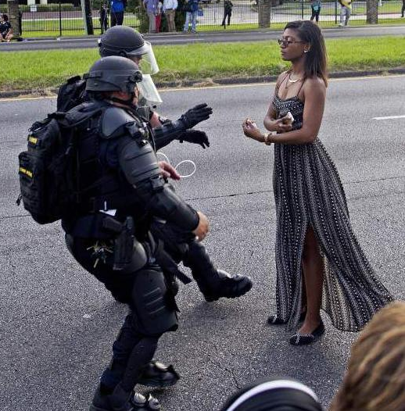
power
power
within
over
with
Which do we model in our classrooms?
Notes:
(Sasha's slide)
Ieshia Evans, Baton Rouge, 2016

Slide 10
Inward / Individual Work
&
Outward / Collective Work
Notes:
(Sasha's slide) We can't solve racism alone. It is about relationships. And I want my anti-racist activism to be about building relationships, about deepening them, even and especially across differences. So we relationships in the classroom with our students, and help create spaces for them to build relationships with each other. Now we are going to broaden that conversation to include the relationships we have in our communities, first as neighbors, and also professionally. What shape do those relationships take? How do we keep them from being transactional or instrumental?
I have been involved in a group called Showing Up for Racial Justice, and we talk about what that showing up means.
* faculty role as an ally for students – Ferguson story? Story about J?
* Little Village examples
* "your advocacy could range in intensity: it could be as hands on as being on jail support after a protest, or it could also be helping students understand the university's history with policing, or making sure that your course policies are flexible enough to let students turn in work late after attending a protest, etc."

Slide 11
Action in Community and Civic Identity
Jack Nuelle (Program Manager, FCIP)
Susan Haarman (Associate Director, Center for Experiential Learning)

Slide 12
Working Definitions
Action: Meaningful anti-racist action is action based on ongoing work and reflection to educate oneself about racism and systems of injustice, as well as identifying and working to change racist actions and policies.
Advocacy: A comprehensive, consistent effort that includes civic engagement, open discussion of the multivalent and systemic effects of racism, material support of anti-racist causes, and active dismantling of everyday racism²
1. https://www.vox.com/2020/6/3/21278245/antiracist-racism-race-books-resources-antiracism
2. https://publichealth.uic.edu/community-engagement/collaboratory-for-health-justice/a-short-guide-to-advocacy-and-anti-racist-praxis/

Slide 13
Action in Community & Jesuit Education
Jesuit Education has always aimed to educate, not just for academic excellence, but to prepare individuals to be active in the world with their knowledge
  Ratio Studiorum advocated active learning, connecting lessons to current affairs and case studies
  Diego Ledesma on why Jesuits ran schools in the late 1500's
    First, because they supply people with many advantages for practical living; secondly, because they contribute to the right government of public affairs and to the proper making of laws; third, because they give ornament, splendor, and perfection to our rational nature, and fourth, in what is most important, because they are the bulwark of religion and guide us most surely and easily in the achievement of our last end.
Notes:
Note about the series:
Start with ourselves and our experience
Ready ourselves to learn something new
No quick fix to racism! Cultivating the practice of reflection and action to create a more anti-racism classroom
This will be imperfect, this is not an answer to all of your questions
This is a start to the work we all need to do personally and in our teaching ans scholarship

Slide 14
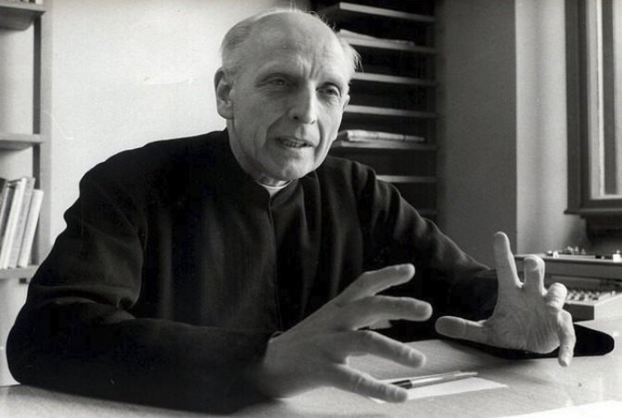
Action in Community & Jesuit Education
Pedro Arrupe's 1973 Address - "Students For and With Others"
  "Men-and-women-for-others: the paramount objective of Jesuit education – basic, advance, and continuing – must now be to form such men and women."
    Reject rampant consumption society,
    Do not make unjust profits,
    Both resist unjust structures and actively
    undertake to reform them
Notes:
Note about the series:
Start with ourselves and our experience
Ready ourselves to learn something new
No quick fix to racism! Cultivating the practice of reflection and action to create a more anti-racism classroom
This will be imperfect, this is not an answer to all of your questions
This is a start to the work we all need to do personally and in our teaching ans scholarship

Slide 15
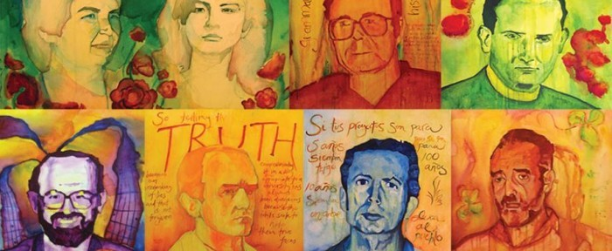
Action in Community & Jesuit Education
Ignacio Ellacuria - 1982 Address to Santa Clara
  The university should be present intellectually where it is needed
Hans Kolvenbach – 2000 Address
  Educate the whole person of solidarity for the real world. Solidarity is learned through contact rather than through concepts.
Notes:
Note about the series:
Start with ourselves and our experience
Ready ourselves to learn something new
No quick fix to racism! Cultivating the practice of reflection and action to create a more anti-racism classroom
This will be imperfect, this is not an answer to all of your questions
This is a start to the work we all need to do personally and in our teaching ans scholarship

Slide 16
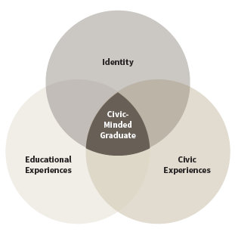
Civic Identity and Students
Civic-Minded Graduate
Nexus where a student’s academic learning, community experiences, and identity overlap
foundational knowledge of what it means to be a member of a community
commitment to democratic participation
Notes:
Note about the series:
Start with ourselves and our experience
Ready ourselves to learn something new
No quick fix to racism! Cultivating the practice of reflection and action to create a more anti-racism classroom
This will be imperfect, this is not an answer to all of your questions
This is a start to the work we all need to do personally and in our teaching ans scholarship

Slide 17
Civic Identity and Students
Civic-Minded Graduate Domains of Learning
Capacity for being a civic agent
Orientation to social change
Understanding of how issues are address in society
Collaboration with others
Sense of civic identity
Valuing being a "social trustee of knowledge"
Notes:
Note about the series:
Start with ourselves and our experience
Ready ourselves to learn something new
No quick fix to racism! Cultivating the practice of reflection and action to create a more anti-racism classroom
This will be imperfect, this is not an answer to all of your questions
This is a start to the work we all need to do personally and in our teaching ans scholarship

Slide 18
Action and Advocacy in the Learning Environment
Sasha Adkins, Ph.D. (Senior Instructor, Institute of Environmental Studies)
Susan Haarman, M Div, M. Ed., LPC (Associate Director, Center for Experiential Learning)
Ruth Gomberg-Muñoz, Ph.D. (Associate Professor, Department of Anthropology)
Sandra Sullivan Dunbar, Ph.D. (Associate Professor, Department of Theology)

Slide 19

Promoting Civic Engagement in the Classroom
Sandra Sullivan Dunbar, Ph.D. (Associate Professor, Department of Theology)

Slide 20

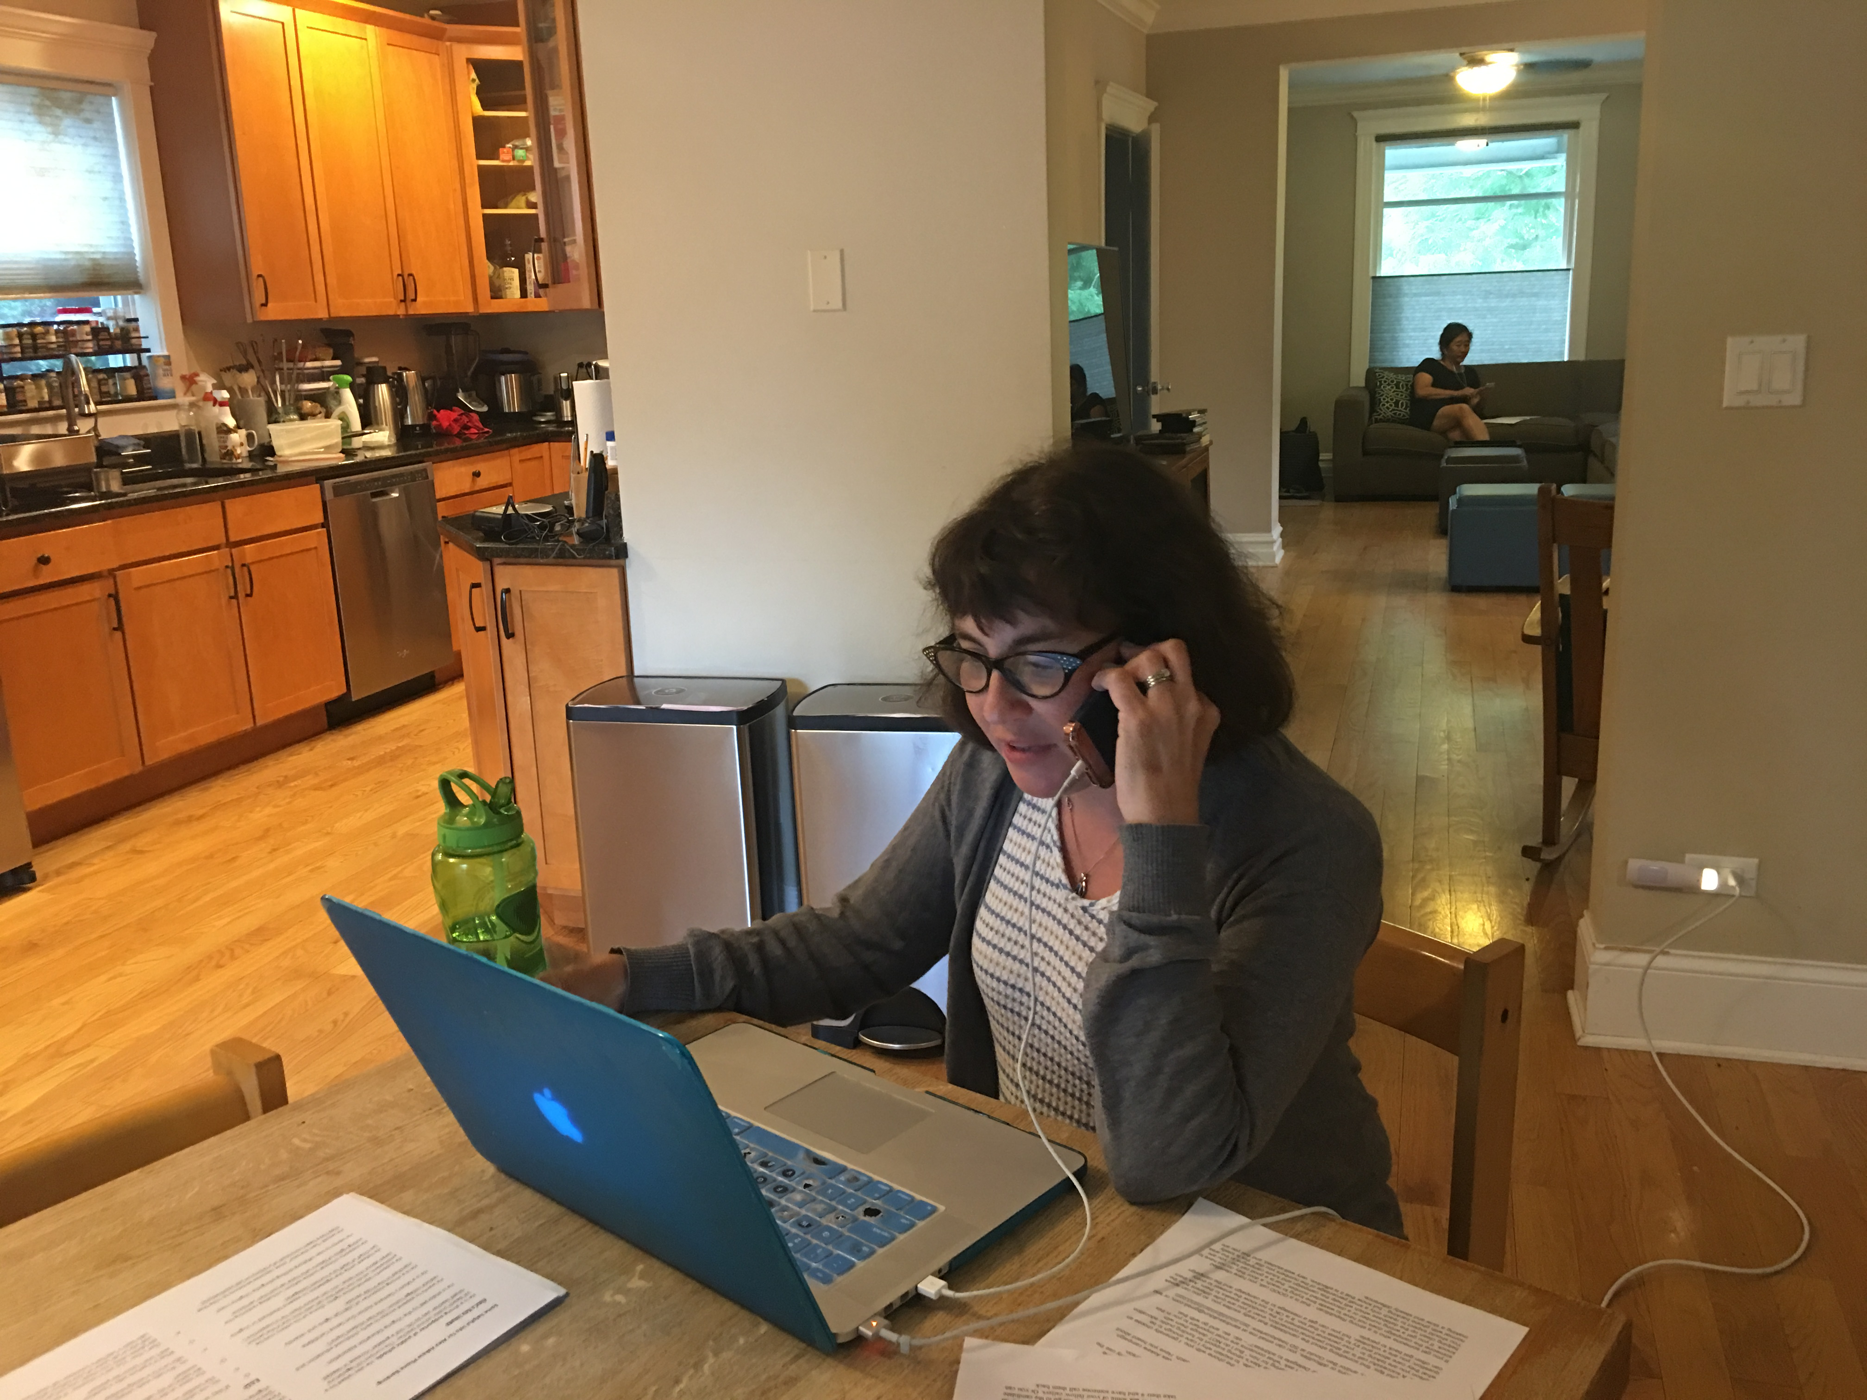
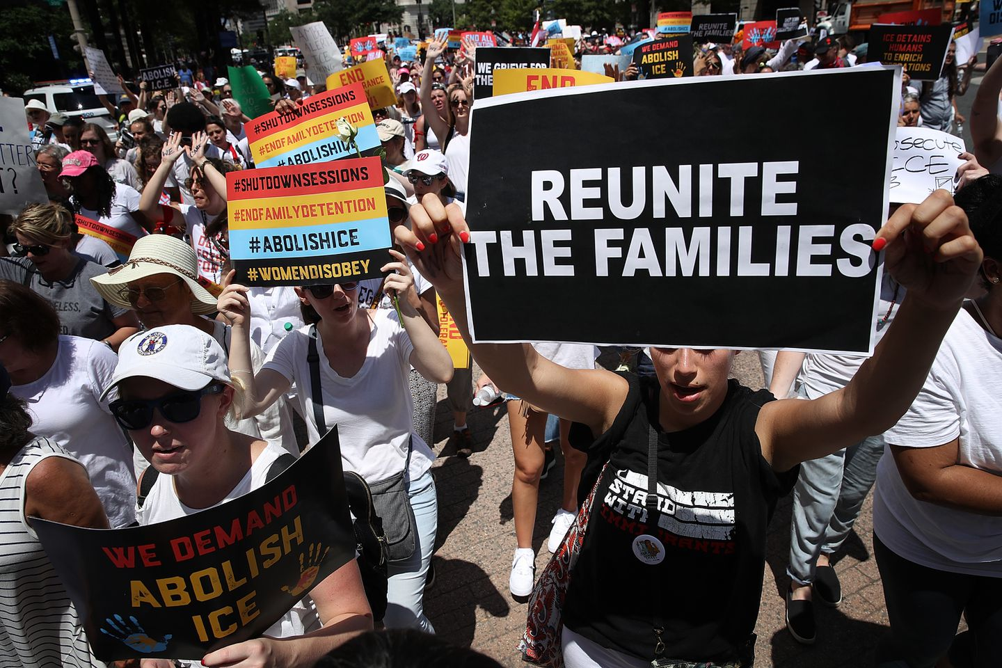

Slide 21
Researching State Voting Laws
Students are divided into groups and given a state to research
They are given a Google Doc of research resources
They look up:
  Deadlines to register
  Rules for who can order an absentee ballot, and deadlines for returning
  Whether voter ID is required, and what kind of voter ID is accepted
  Whether there is early voting and when it starts
  Whether felons can vote, and if so, when
In the process, they gain practical information as well as an awareness of voter suppression, how students are targeted, and importance of state election and voter laws

Slide 22
Teaching students how to contact their legislators
I provide a Google Doc with links that help students learn:
How to find out who their legislators are
How to find their phone numbers
How to make their call as effective as possible
How to call even if they have social anxiety
How to fax their legislator
How to find out what their legislator is voting on this week

Slide 23
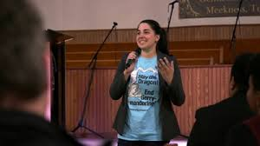
Teaching students to research candidates
Ballotpedia
Open Secrets
SmartVote
Candidate web sites
Tracking news coverage
Social media
Politifact
Voting guides on judicial races
Countering cynicism

Slide 24
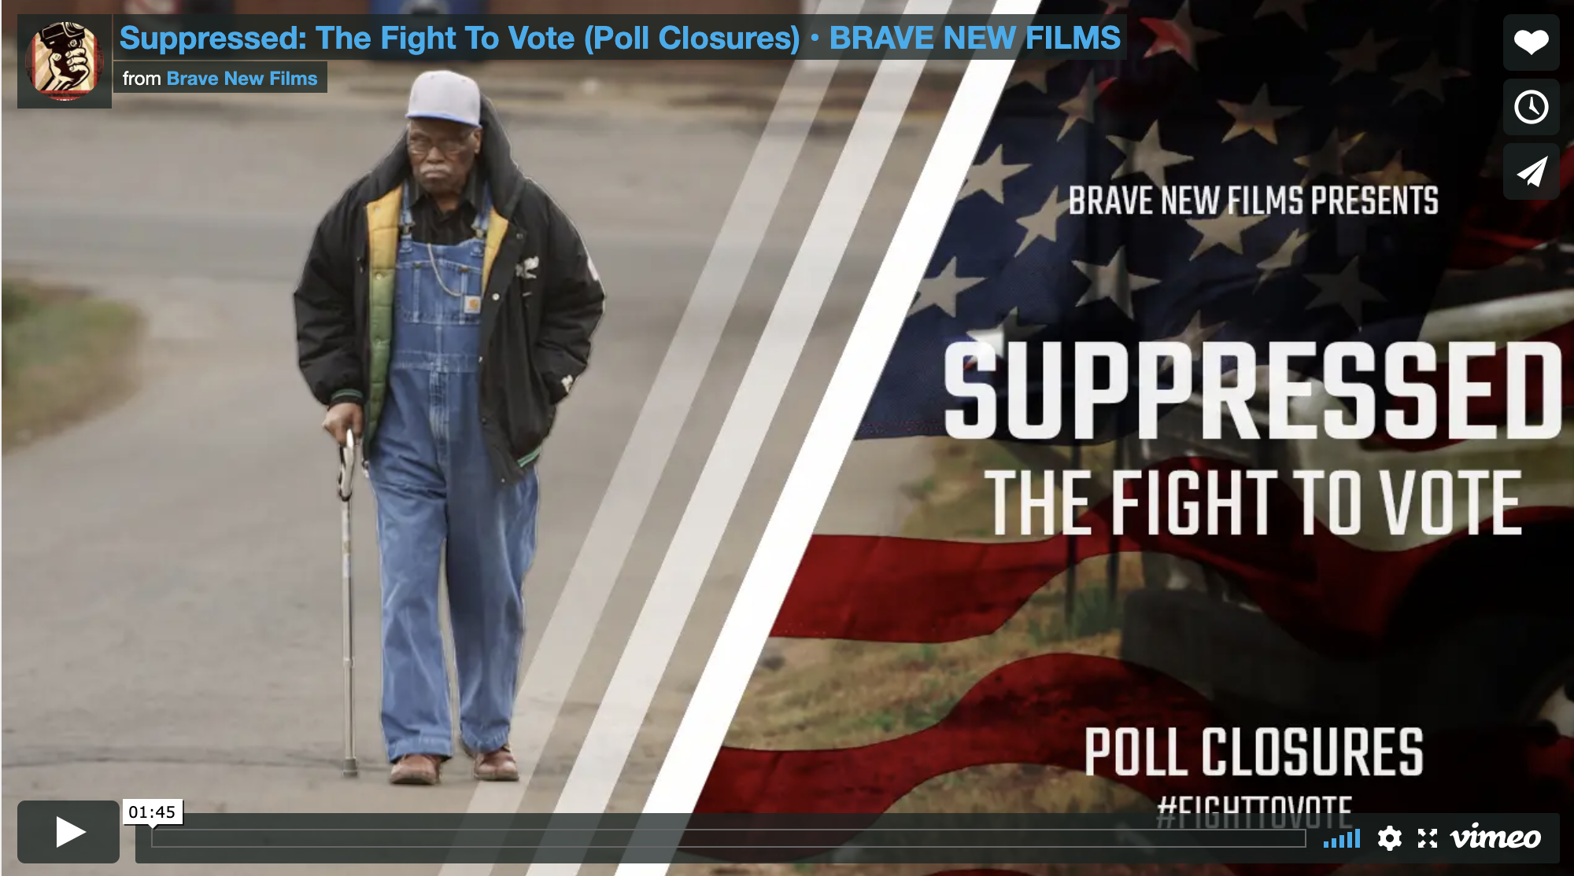
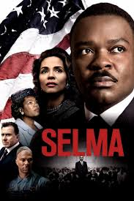
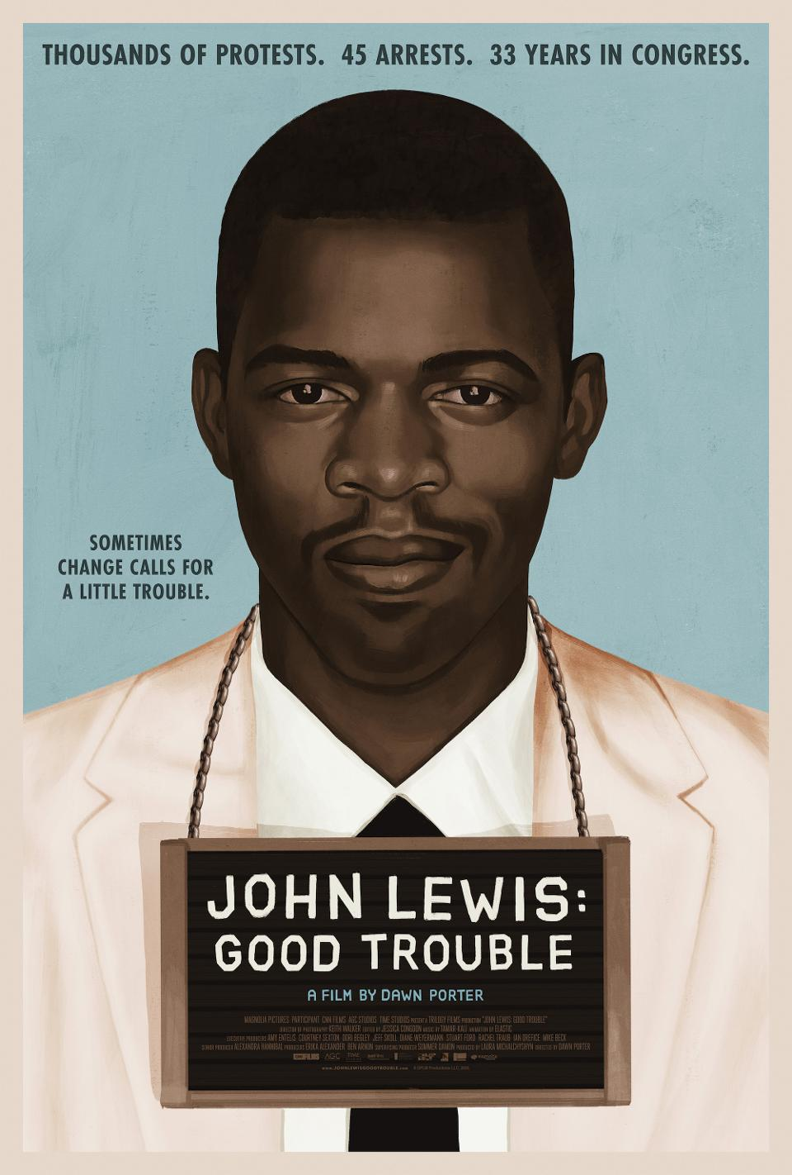


Slide 25
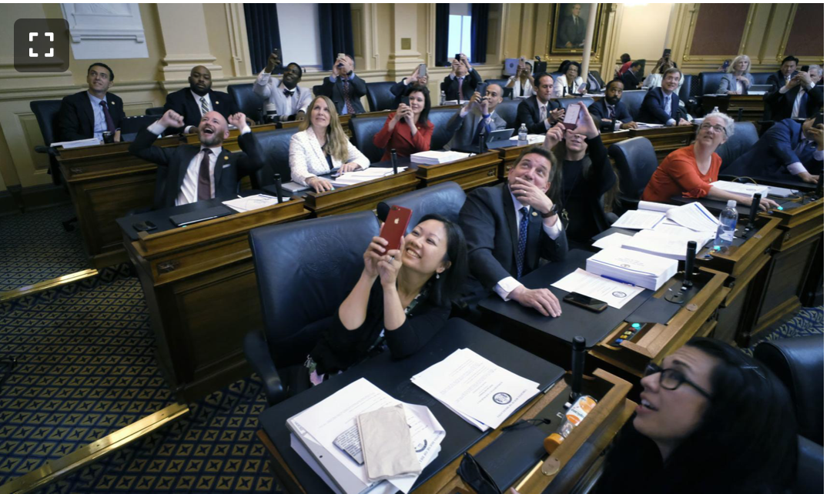
Emphasizing state and local elections
I emphasize that students have state and local legislators as well. Some students don’t know this!
While there is gridlock in DC, state legislators can have a big impact on voting rights, public health (coronavirus!), gun laws, environmental protection, education.
Criminal justice policy is made primarily at the state and local level.
With a state or local elected official, you are a much bigger fish in their sea. If you call them you might be one of five calls that day!

Slide 26
Media Literacy
I am working on finding ways to teach critical media consumption
It’s hard – you can give some basic tools for critical media consumption, but to really get good at it is a lifetime project.
I emphasize that news sources are like friends. You have to hang out with them for a while, see them make mistakes and how they handle that, watch them interact with others, get to know their foibles and what kinds of things you can rely on them for, and what kinds of things for which it is best to turn to other sources. You need more than one friend!
Semester-long social justice research projects provide one way for students to engage over time with varied sources on the same topic and learn who to trust.

Slide 27
Some resources for sharpening students’ critical media consumption skills:
News Literacy Project (newslit.org) – has some quizzes on evaluating news reporting and sources.
Stanford University’s Civic Online Reasoning Project: cor.Stanford.edu
American Association of State Colleges and Universities Digital Polarization Project: www.aascu.org/AcademicAffairs/ADP/DigiPo/
I am becoming a sort of Google Doc librarian and have collected plenty of resources that are not easily listed in a PowerPoint. Particularly relevant to this AntiRacist Pedagogy series, a number of voices are emerging that question the notion or desirability of “objectivity” in journalism, where this represses voices of those from marginalized spaces. Happy to share!

Slide 28
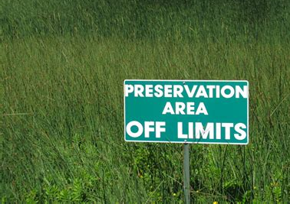
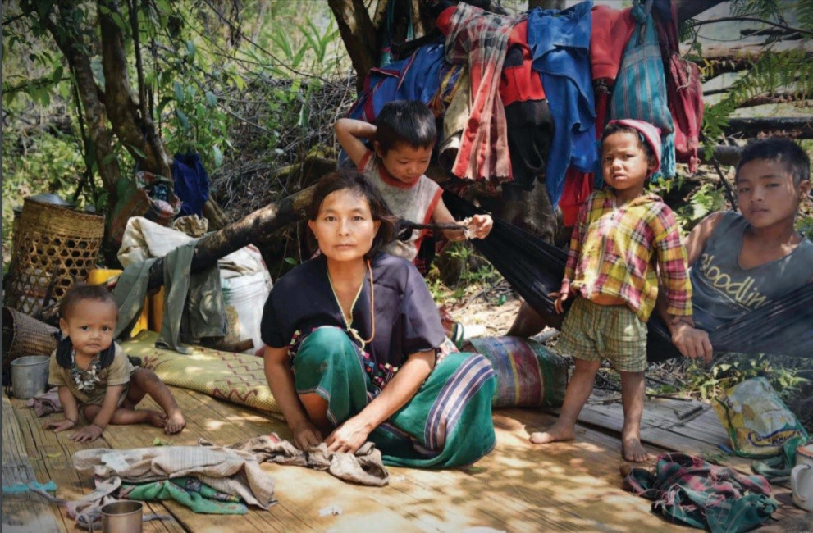
fortress conservation

Slide 29
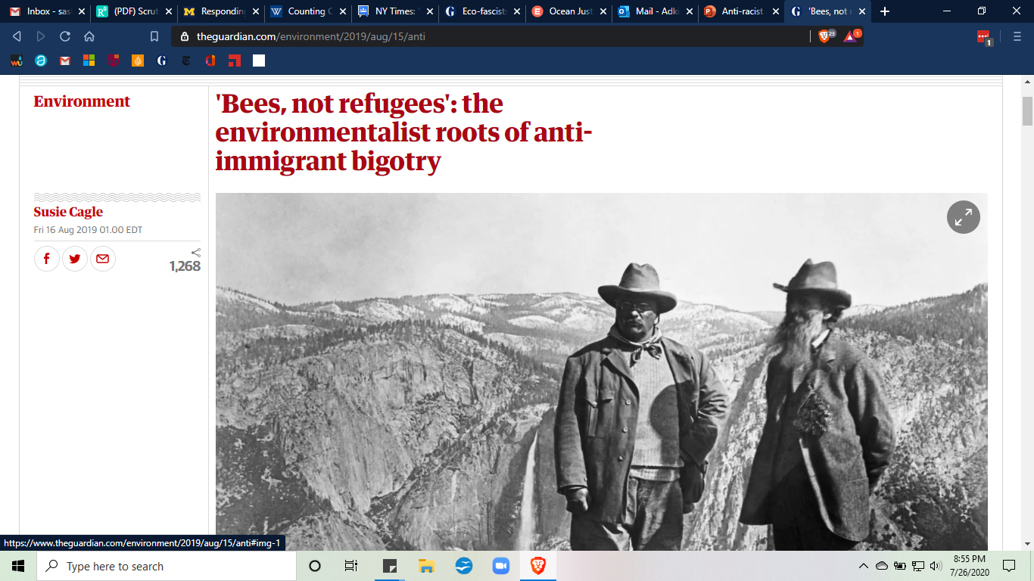
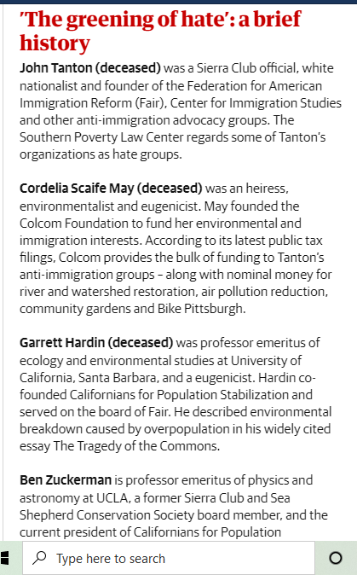
Notes:
https://www.theguardian.com/environment/2019/aug/15/anti
https://www.theguardian.com/environment/2019/nov/30/eco-fascists-and-the-ugly-fight-for-our-way-of-life-as-the-environment-disintegrates

Slide 30

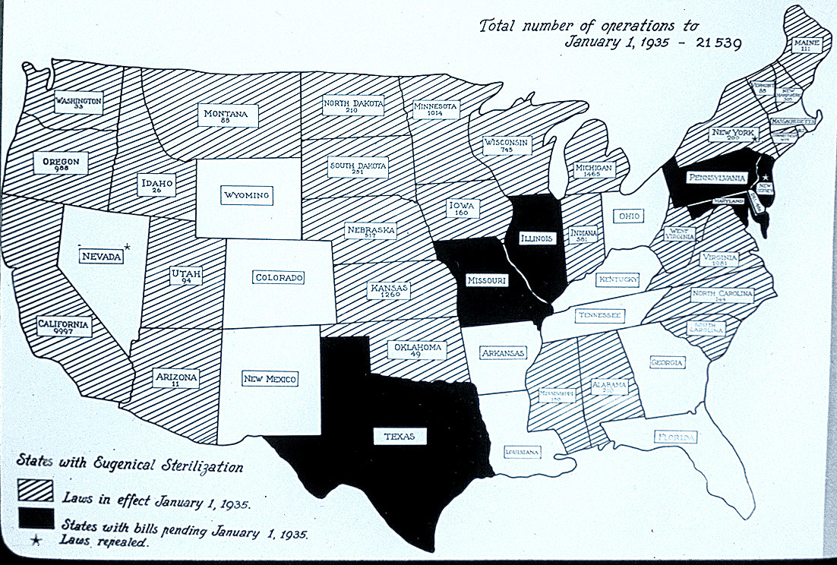


Notes:
http://www.pbs.org/independentlens/blog/unwanted-sterilization-and-eugenics-programs-in-the-united-states/
http://www.news.ucsb.edu/2015/015287/politics-female-biology-and-reproduction
and https://www.npr.org/sections/health-shots/2016/03/07/469478098/the-supreme-court-ruling-that-led-to-70-000-forced-sterilizations

Slide 31
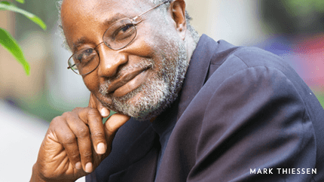
John Francis
Notes:
(Sasha's slide)

Slide 32
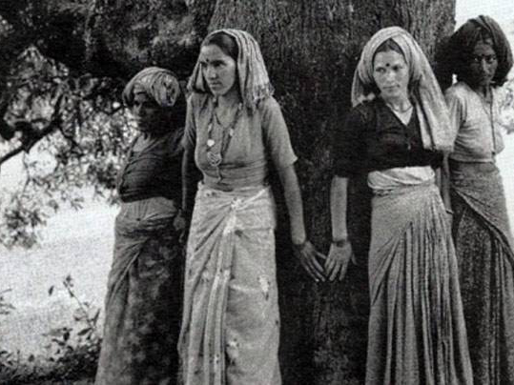
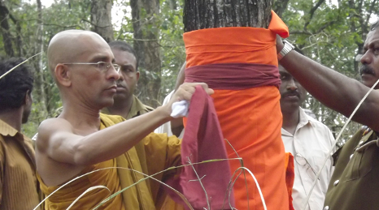
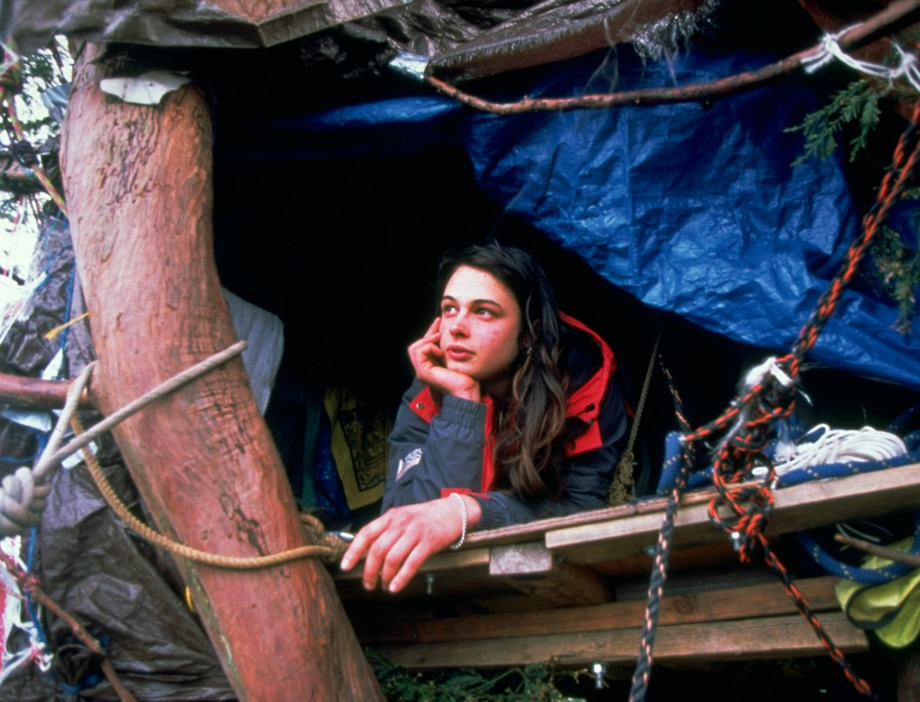
Notes:
(Sasha's slide) positionality in activism – Are you a treehugger? What does it mean to be a treehugger?

Slide 33
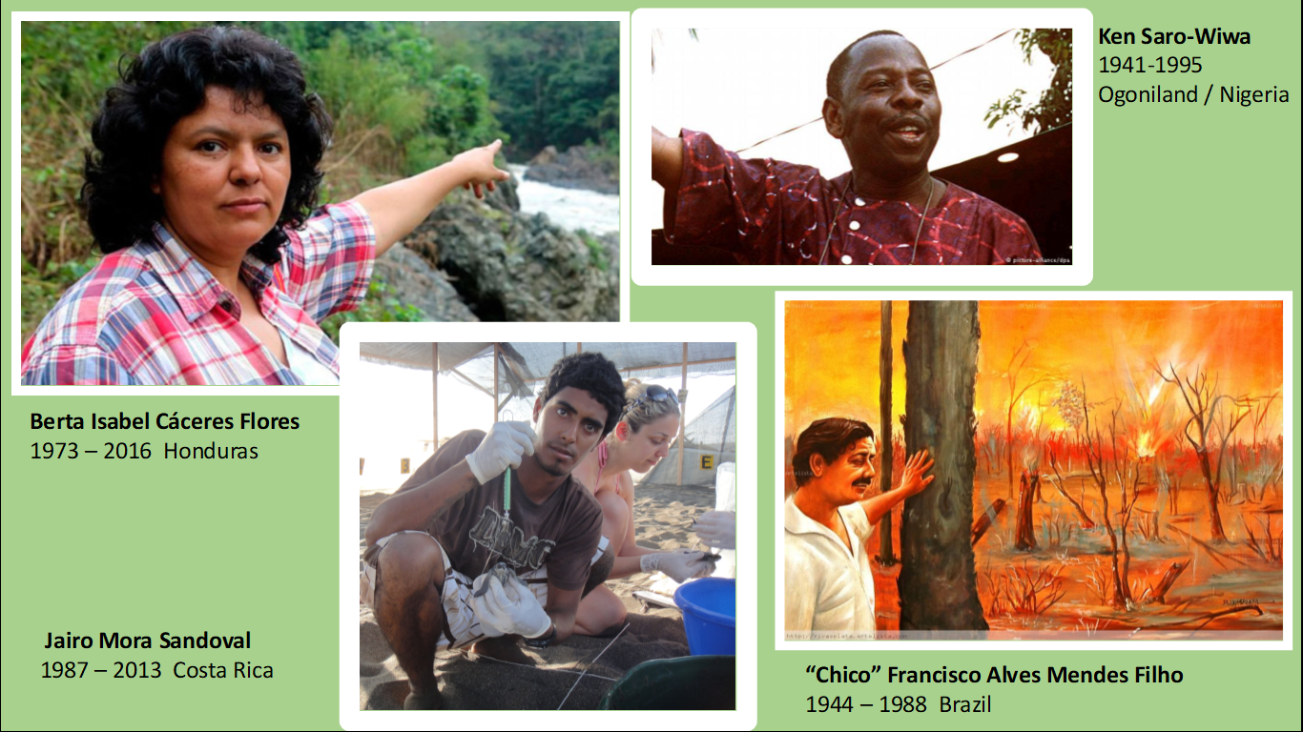
Notes:
(Sasha's slide) environmental privilege, and recognizing that the level of risk varies with social position

Slide 34
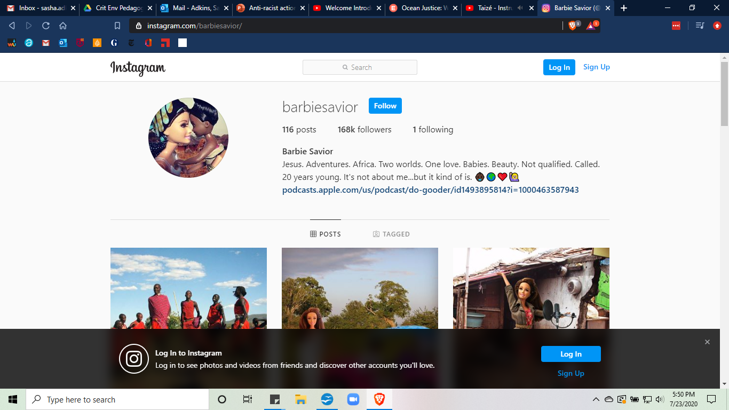
Beware White Savior Complex
Notes:
(Sasha's slide)

Slide 35
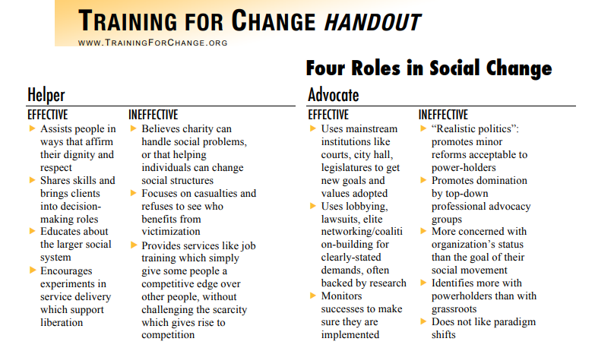
Notes:
(Sasha's slide)

Slide 36
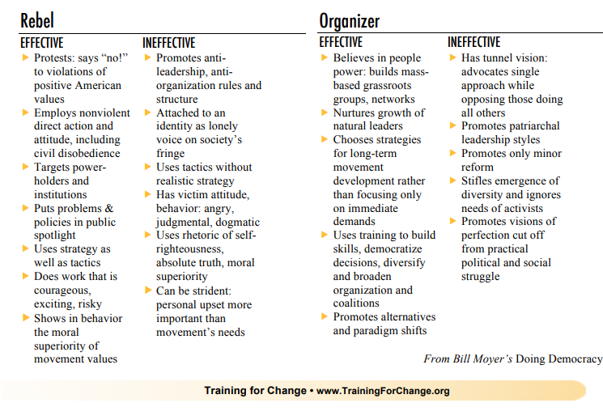
Notes:
(Sasha's slide)

Slide 37

https://beautifultrouble.org/
Notes:
(Sasha's slide) values clarification on what strategies students resonate with, and which push beyond their comfort zone, I give powerpoint on examples of various types of activism, from within the judicial system to legislative to prefigurative (free harvest supper) to artistic (Bread & Puppets) to economic (boycotts, divestment) to civil disobedience (Bidder 70 about Tim DeChristopher).

Slide 38
Engaged Learning at LUC:
An Opportunity for Advocacy, Action, and Centering Community Wisdom
Susan Haarman, M Div, M. Ed., LPC (Associate Director, CEL)
Ruth Gomberg-Muñoz, Ph.D. (Associate Professor, Department of Anthropology

Slide 39
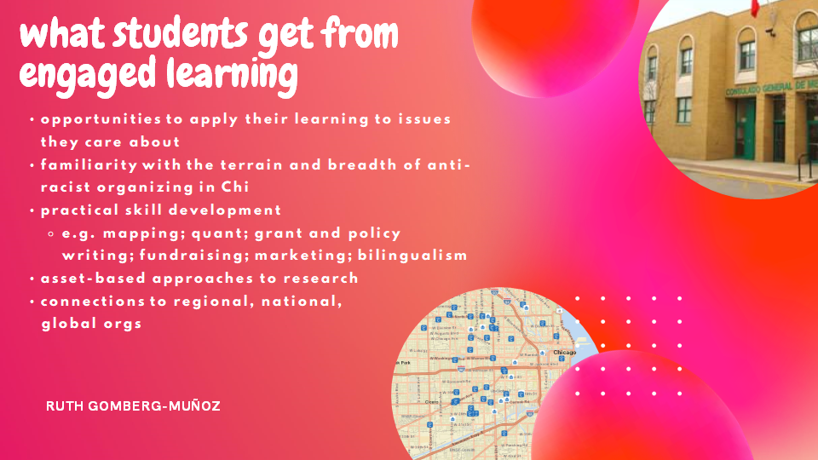

Slide 40
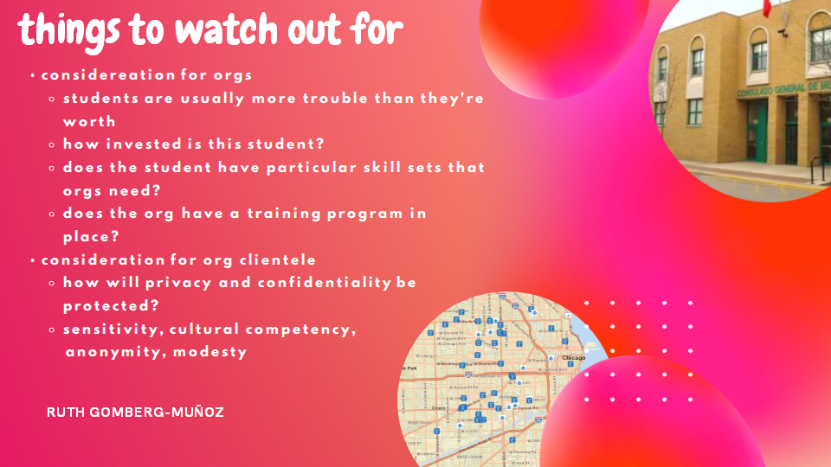

Slide 41
Engaged Learning at LUC
  The Engaged Learning Requirement
Official course designation
A structured learning experience integrated into a course that engages students in learning outside the classroom, such as in a community agency, professional organization, or in a research setting
Critical reflection on that experience through various assignments in class
Synthesis of the experience through a final project or portfolio

Slide 42
Engaged Learning at LUC
  The Engaged Learning Requirement
  Fieldwork
  Public Performance
  Academic Internships
  Service-Learning
  Undergraduate Research

Slide 43
Service-Learning
  Service-Learning
  20 hours of work done with community organization either on site or in project form
  Community engagement is "another essential text on the syllabus"
  Center community voice as an essential perspective in knowledge creation
  Build crucial relationships and concretizes, contextualizes, and challenges concepts from class

Slide 44
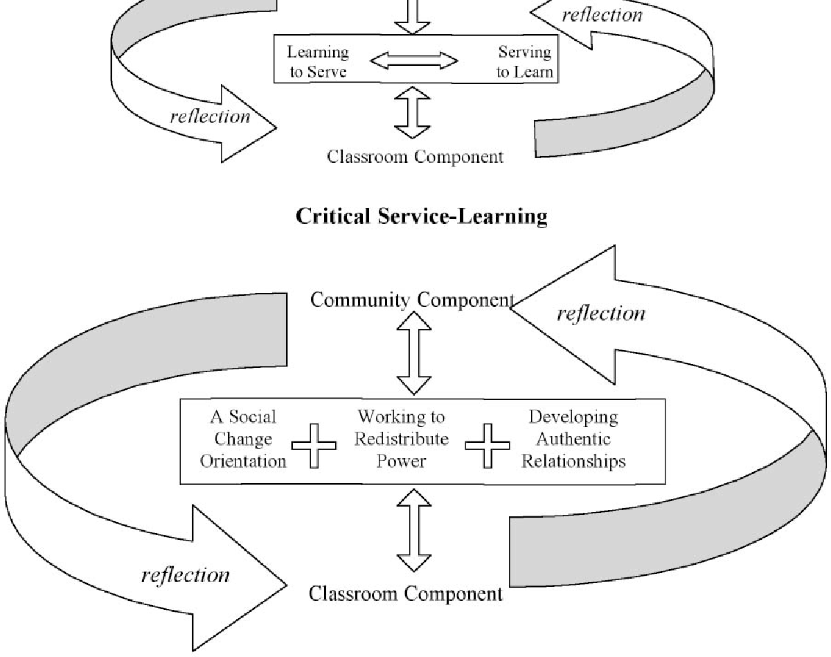
Critical Service-Learning: The CEL's Approach
  Critical Service-Learning
  Social Change Orientation
  Working to Redistribute Power
  Developing Authentic Relationships

Slide 45
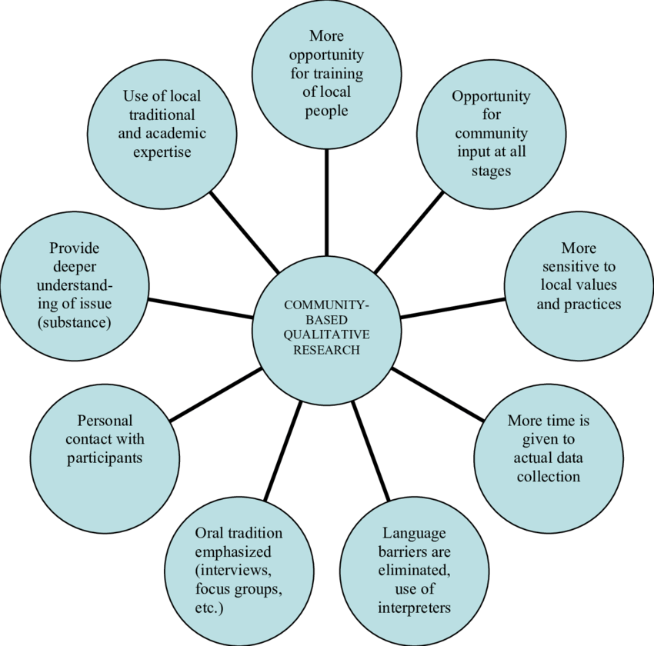
Community-Based Undergraduate Research
  Community-Based Research
  Community members surface the research question
  Community is actively involved in determining and sometimes assisting with methods, feedback, and research dissemination
  Community Research Fellowship at LUC

Slide 46
Supporting Students from Marginalized Groups
Rebecca Valeriano-Flores
MA Philosophy, Current PhD Student in Philosophy
Minorities and Philosophy Lead Organizer (2018-20)
Samuel A. Attoh Award for Diversity and Inclusion

Slide 47
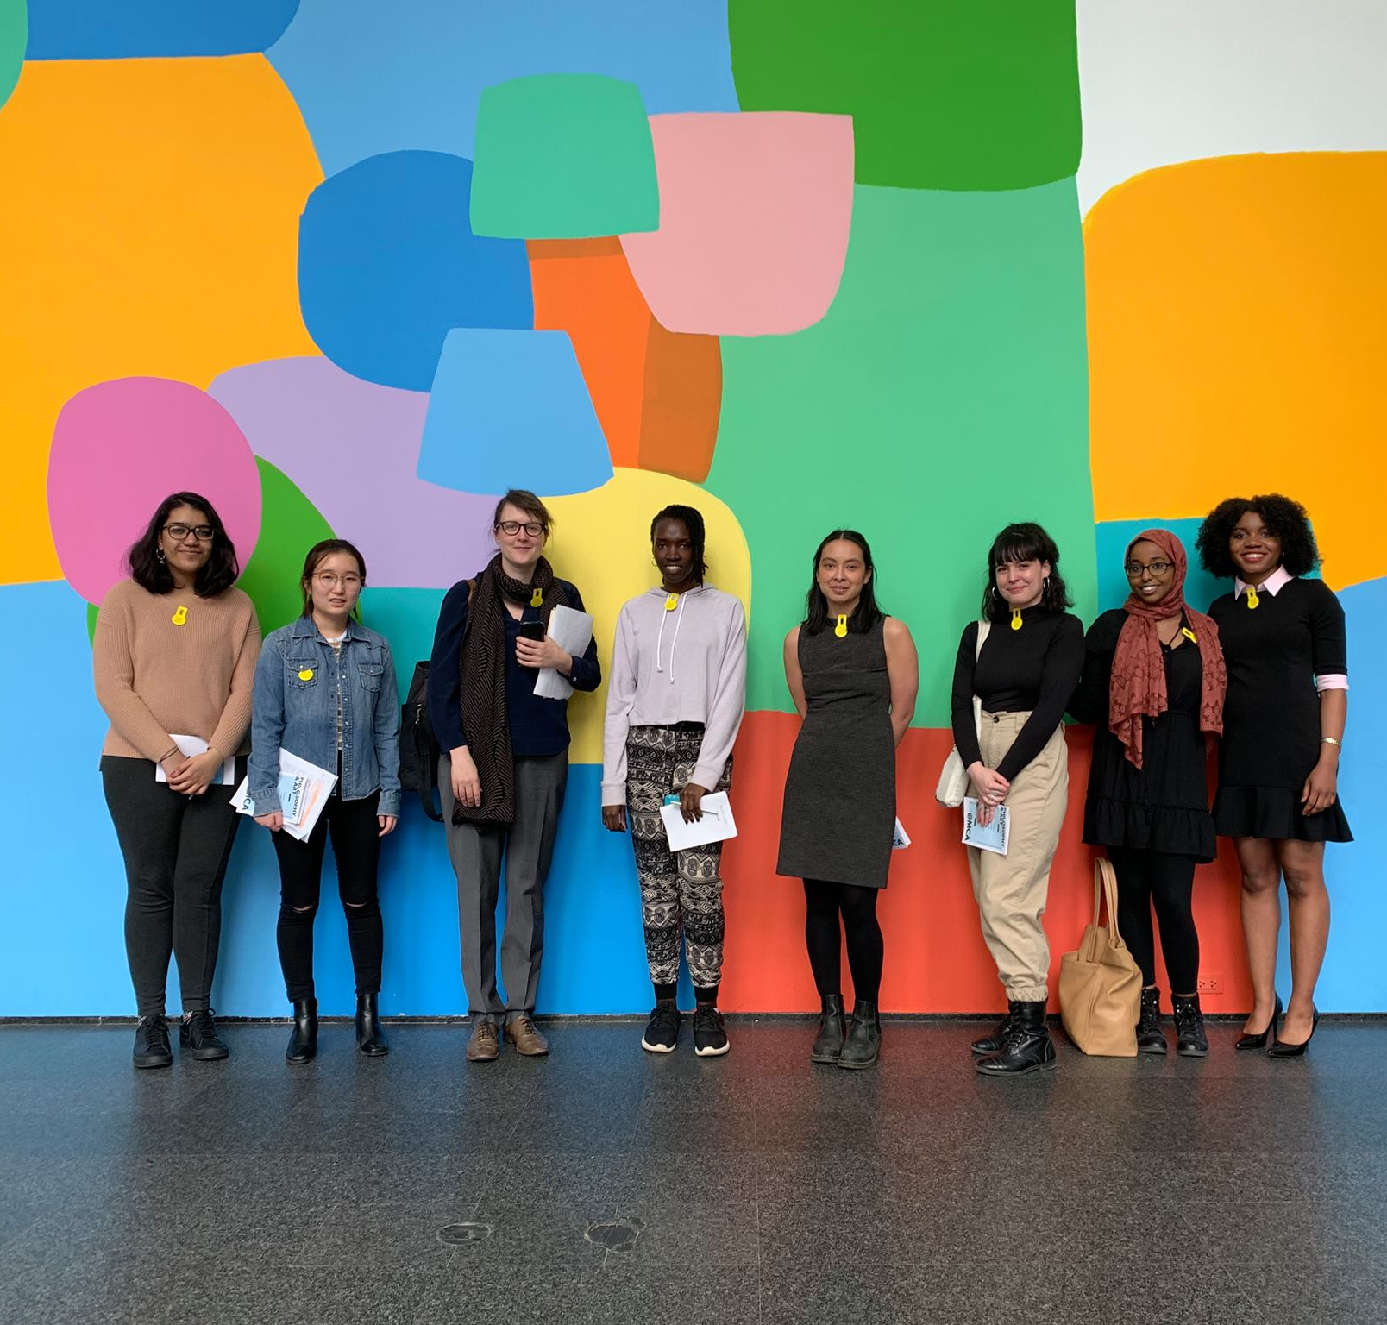
Minorities and Philosophy, LUC Chapter
"I think that MAP lounge was a great addition because it made the program's resources and community more accessible. I feel like I was able to make the most of the program since time spent in the lounge helped me build relationships with other members of the community that would not have been possible (at least not in the same capacity) if we only met for talks and department events."
Undergraduate membership doubled from first year to second year
Engaged students (student research, participation in activities and reading groups)
Supportive environment
Two hires in philosophy of race and paid undergraduate assistant position
http://bit.ly/LoyolaMAP

Slide 48

Gatekeeper vs. Usher
Gatekeeper
Only mentoring students who show "talent" in your field, who are already "good students"
Usher
Mentoring and reaching out to students, especially BIPOC students, regardless of "talent"
"You are not good enough to be here."
"You have a place here!"

Slide 49
Transforming Values
Interrogate and reevaluate values such as "talent" and "good student"
These values are implicitly racialized—standards based on successes of students with privilege
Beyond the classroom: analyze our values of "good" and "bad" to see how they have been shaped by anti-black racism
In doing so, we transform our values, classroom, academy, consciousness

Slide 50
High Impact Practices (HIPs)
First Year Seminars and Experiences
Common Intellectual Experiences
Learning Communities
Writing-Intensive Courses
Collaborative Assignments and Projects
Undergraduate Research
Diversity/Global Learning
ePortfolios
Service Learning and Community-Based Learning
Internships
Capstone Courses and Projects
AACU, High-Impact Educational Practices: https://www.aacu.org/node/4084

Slide 51
Key Insights: HIPs are not enough
Should be part of a larger effort for departmental change. (Easier said than done: think about positionality.)
Organizing and programming should center and be accountable to students from marginalized groups.
Diversity and inclusion should be part of the organizational structure itself: horizontal, collaborative, accountable
Requires an ongoing engagement with anti-racist pedagogy and literature.

Slide 52

Follow Their Lead
Take cues from those already doing the work
Researchers in our own disciplines
Young black trans/queer activists
Takes humility and vulnerability
Black Lives Matter Chicago
Brave Space Alliance
Assata's Daughters
Chicago Freedom School

Slide 53




ARPS
ANTI-RACIST RESEARCH
RUTH GOMBERG-MUÑOZ
July 2020

Slide 54
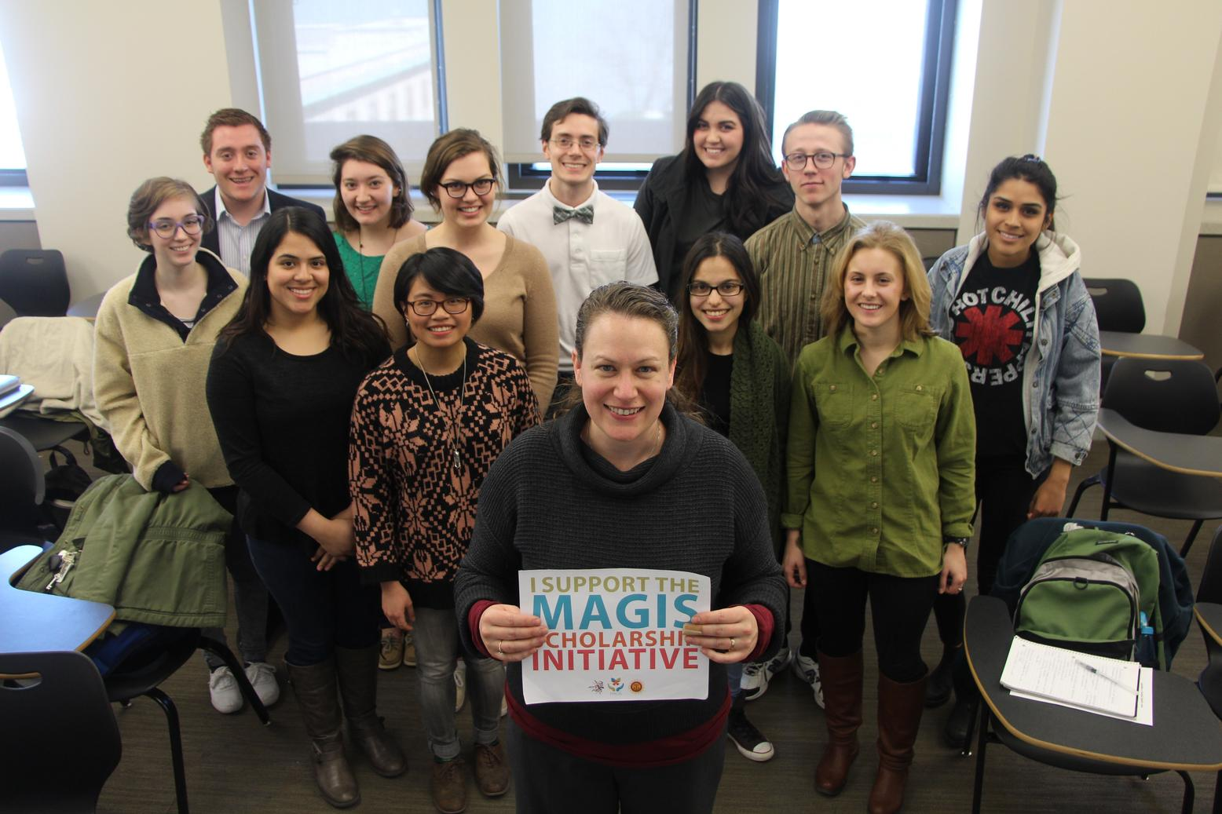
Who am I?
02
ARPS JULY 2020

Slide 55
Developing anti-racist research agendas
STEP 1
STEP 2
STEP 3
OUTREACH
  Who is doing anti-racist work that you respect?
SELF-ASSESS
  What skills and resources can you access?
COLLABORATE
  How can research support anti-racist efforts?

Slide 56
Step 1: Outreach
BE AVAILABLE AND CONSISTENT
CHECK IN REGULARLY (IT'S A MARATHON)
ARPS | JULY 2020
DO WORK YOU WEREN'T TRAINED TO DO

Slide 57
Step 2: Self-Assess
WHAT SKILLS DO I HAVE?
WHAT RESOURCES CAN I GET?
ARPS | JULY 2020
HOW CAN I DEVELOP MY SKILLS AND RESOURCES TO BE MORE USEFUL?

Slide 58
Step 3: Collaborate
RELATIONSHIPS ARE KEY!
DO THE HEAVY LIFTING
ARPS | JULY 2020
THE GOALS OF THE RESEARCH ARE THE GOALS OF THE ORGANIZATION

Slide 59
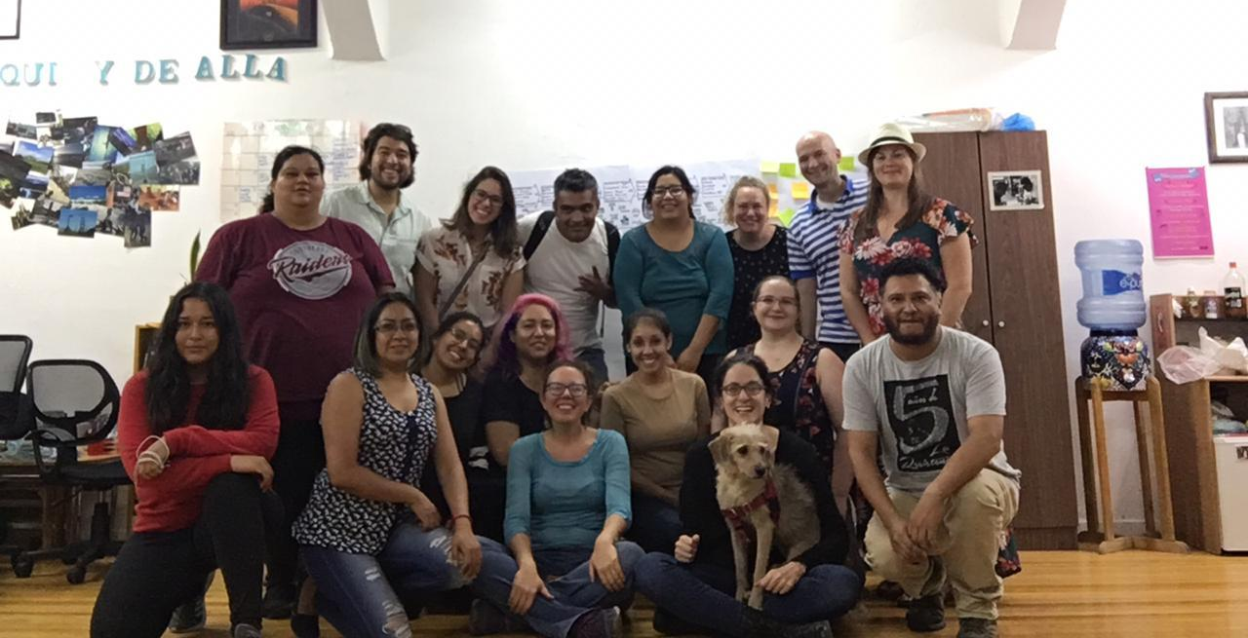
project solidarity
01
APRS | JULY 2020

Slide 60
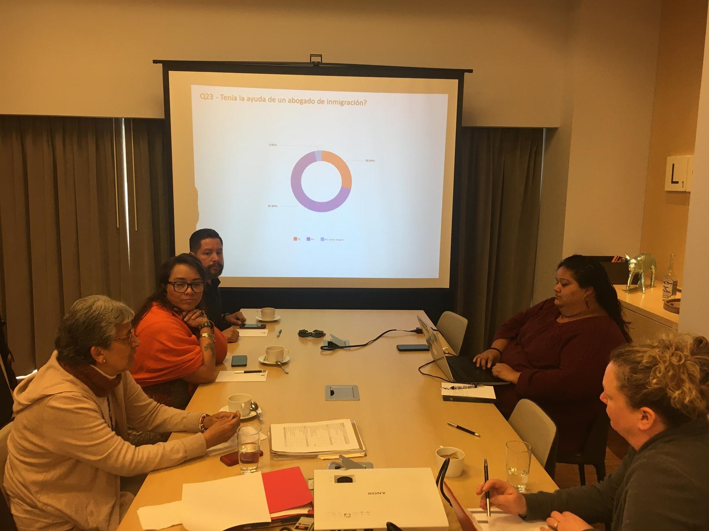
PROJECT SOLIDARITY
RESOURCES
  grant funding for: 1. compensation; 2. technology; 3. infrastructure; 4. training
RESEARCH PRODUCTS
  policy documents; public reports; policy recommendations; webinars; op-eds, etc
ARPS | JULY 2020

Slide 61
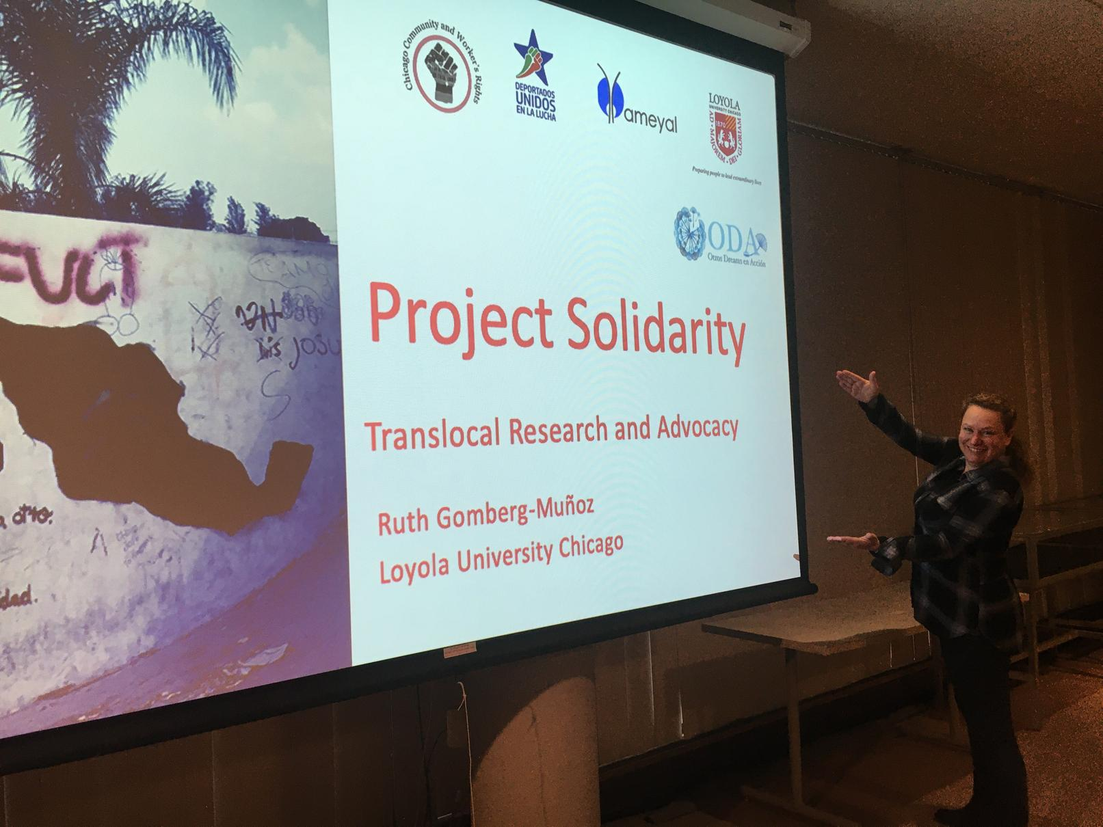
PROJECT SOLIDARITY
TRAINING AND INFRASTRUCTURE
  translocal mapping project: Mapa Solidaridad
  training in GIS and WebApp development
AMPLIFICATION
  The mobility project
ARPS | JULY 2020

Slide 62



In sum
STEP 1
Build relationships with ppl doing anti-racist work
STEP 2
Bring something to the table
STEP 3
Collaborate toward shared goals
ARPS | JULY 2020

Slide 63
Creating opportunities
01
  Outreach (again)
  Start early
  Think outside of semester timeframes
  Be a good collaborator
FOR ENGAGED LEARNING
RUTH GOMBERG-MUÑOZ

Slide 64
Building Relationships with Community
  Tips from the Center for Experiential Learning
  Don't be afraid to start small – guest lecturing, text recommendations, etc
  View and talkt about Community Partners as co-educators and honor their expertise
  Be open to feedback and the potential of long-term projects
  Don't promise what you can't give and follow through with commitments
  Use your personal and professional connections to make connections AND where possible, integrate them more deeply into LUC
  www.luc.edu/cel

Slide 65

Breakout Sessions
  Discussion Questions
  What are examples of concrete actions you can take in your course to be a better advocate and actor for anti-racism?
  Consider your positionality –what do you have that you can bring to the table?
  How can we work to help Loyola University Chicago, as an institution, shift toward becoming an actively anti-racist institution?

Slide 66
Questions?
We have some time left over for discussion

Slide 67
Evaluation
FCIP and the presenters appreciate your feedback. We will use it to inform the remaining sessions.

Slide 68
Resources
Guide to Anti-racist advocacy and praxis, University of Illinois at Chicago
Resources on anti-racism, Vox.com
High-Impact Educational Practices, AACU
Relevant Organizations
Black Lives Matter Chicago
Brave Space Alliance
Assata's Daughters
Chicago Freedom School
Minorities and Philosophy Chapter
Beautiful Trouble Project

